Slide 1

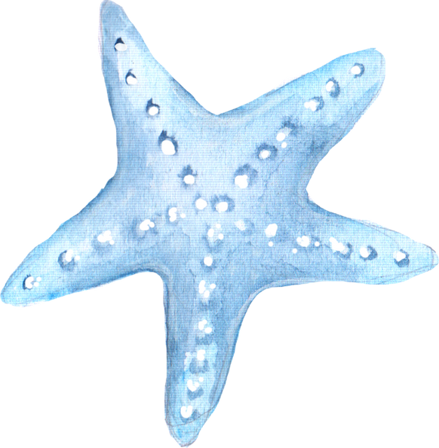
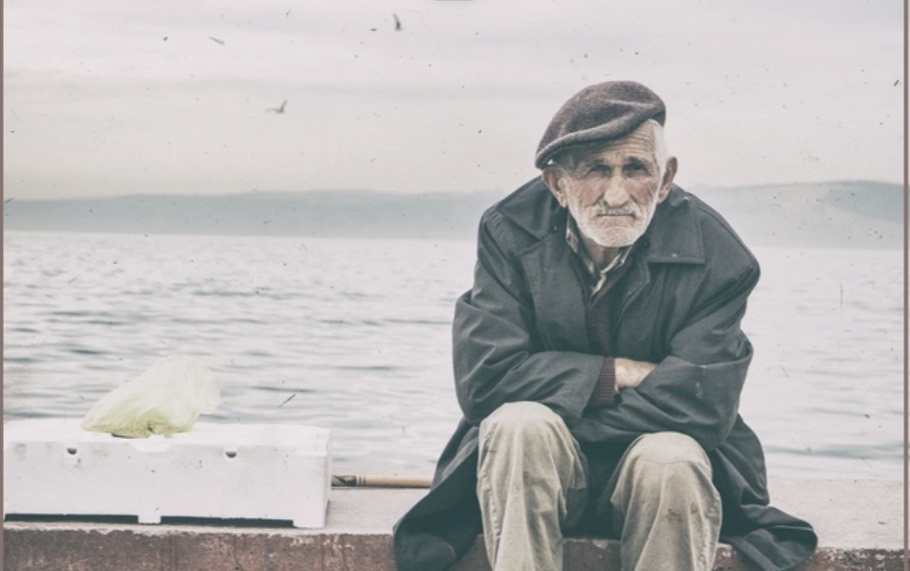
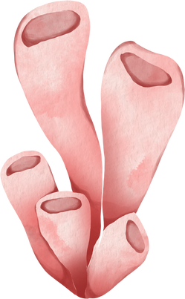
THE CODE OF HONOR
The Code of Honor in The Old Man and the Sea is central to Santiago's character and drives much of the story's emotional and philosophical depth.

Slide 2

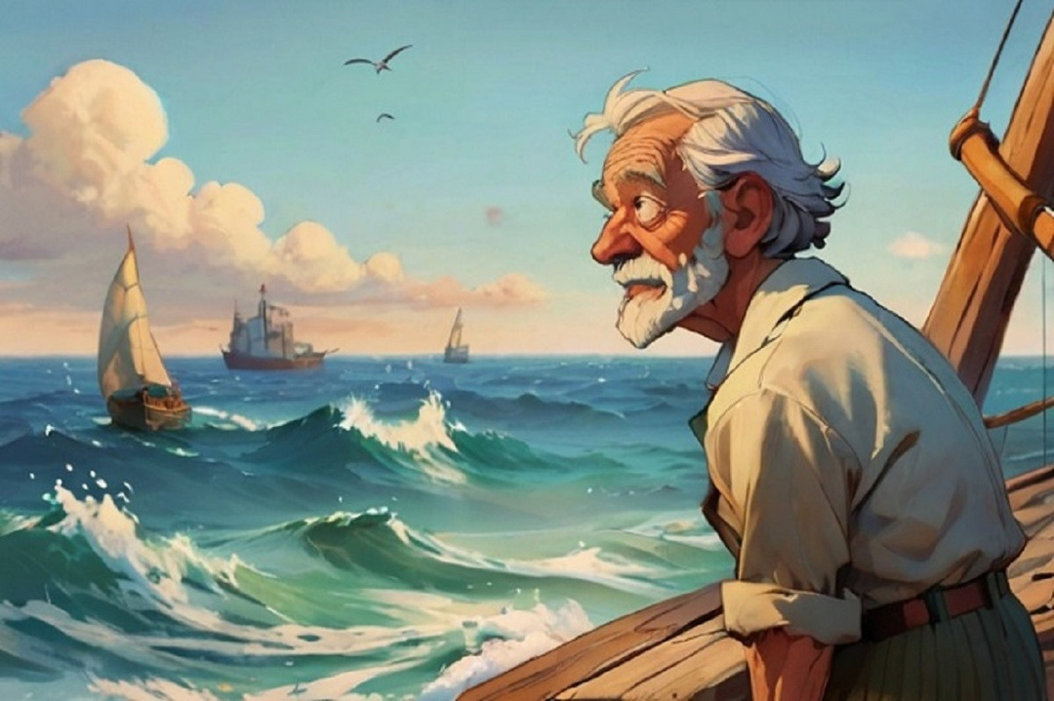


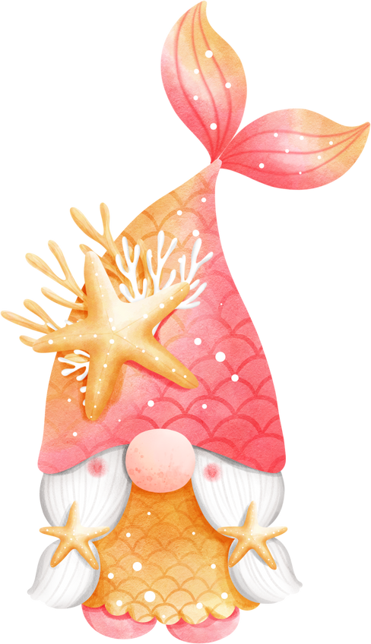

PERSEVERANCE AND ENDURANCE
Santiago's relentless determination to catch the marlin, despite his age and physical limitations, showcases his unyielding spirit.
"A MAN CAN BE DESTROYED BUT NOT DEFEATED."

Slide 3
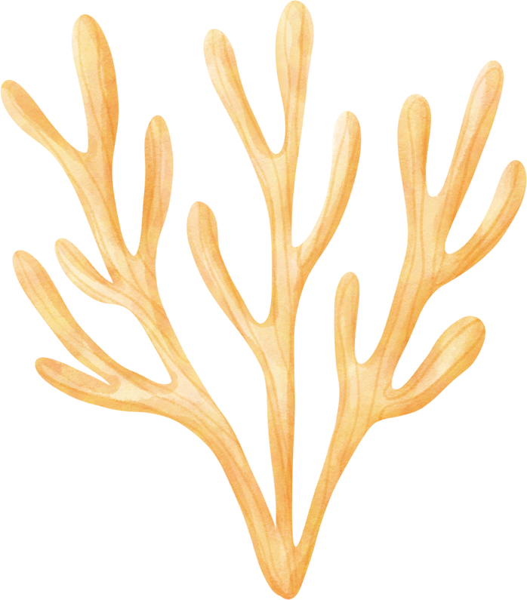

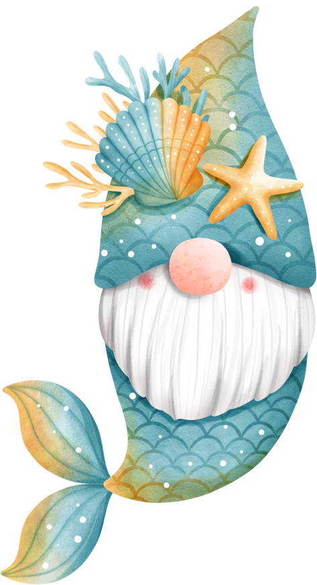
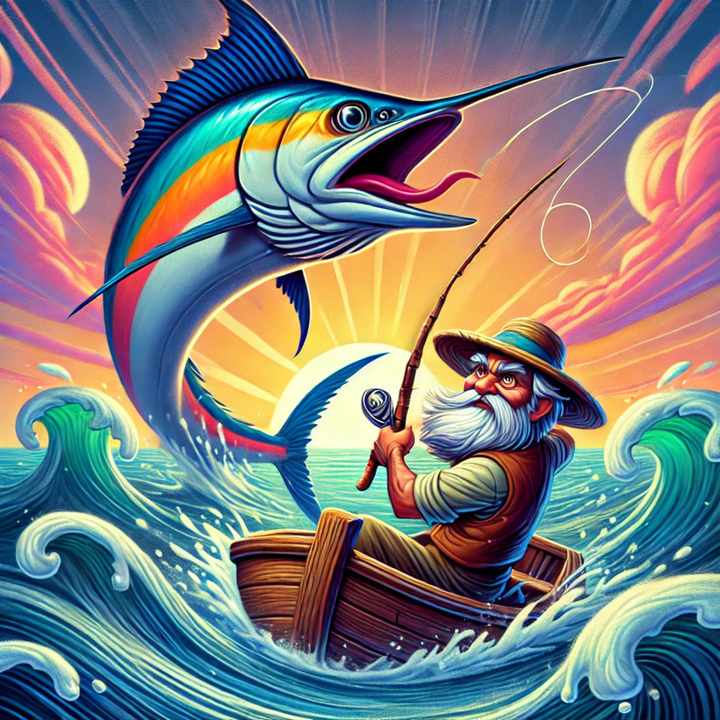


PRIDE AND PERSONAL DIGNITY
Santiago takes great pride in his skills as a fisherman and his ability to endure hardships. His struggle with the marlin is a testament to his pride and sense of self-worth.

Slide 4
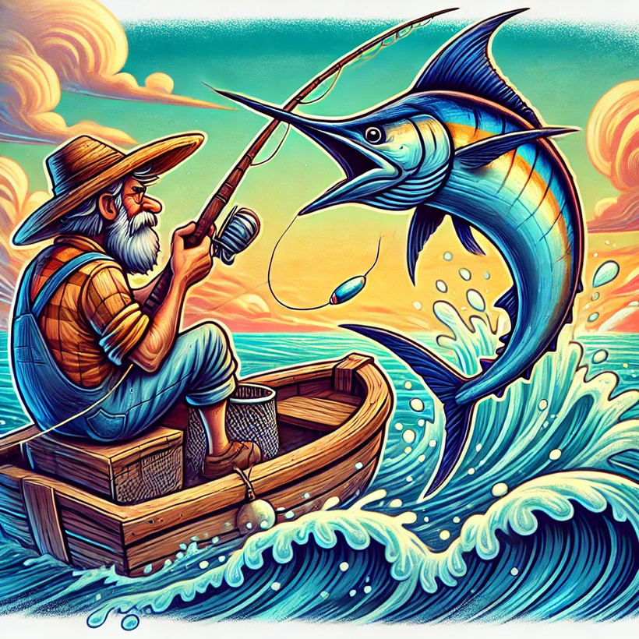
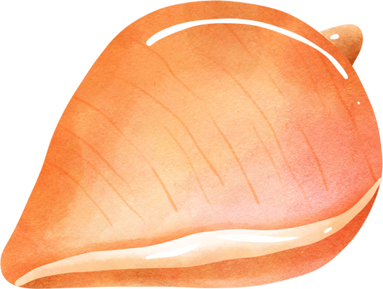
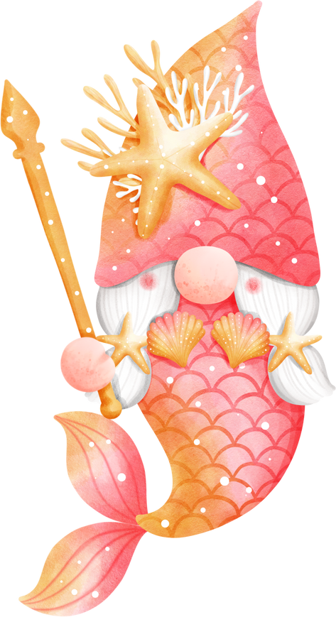
RESPECT FOR NATURE
Santiago respects the marlin as a worthy opponent and refers to it as his "brother," showing his deep appreciation for the natural world and its creatures.

Slide 5

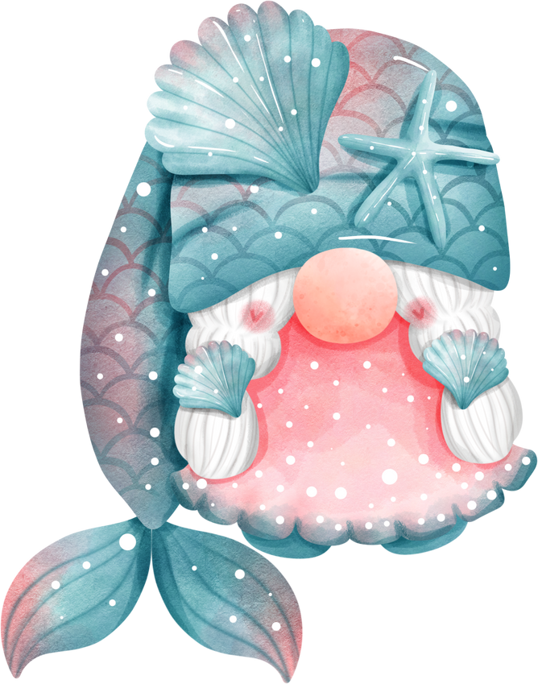
IMPACT OF THE CODE OF HONOR
His code gives his life meaning, defining his identity as a fisherman and a man. The code elevates Santiago’s struggle from a mere battle for survival to a testament to human resilience and dignity.

Slide 6






Stoicism:The Old Man and The Sea
Ernest Hemingway

Slide 7

Overview
Introduction
Core Idea
Character Analysis
-Santiago
-Manolin
-The Marlin

Slide 8
Overview
Introduction
Core Idea
Character Analysis
-Santiago
-Manolin
-The Marlin

Slide 9




Stoicism
Accceptance of Fate
Self-Control
Virtue in Action
Emotional Resilence

Slide 10





Character Analysis
Santiago
Manolin
The Marlin
Acceptance of fate
Self-Discipline
Emotional Damage
Respect for Nature
Respect for Virtue and Wisdom
Loyalty
optimism
Accepting Fate
Living Naturally
A Test of Strength

Slide 11
THANK YOU

